Slide 1
N3H-Core: Neuron-designed Neural Network Accelerator via FPGA-based Heterogeneous Computing Cores

Slide 2
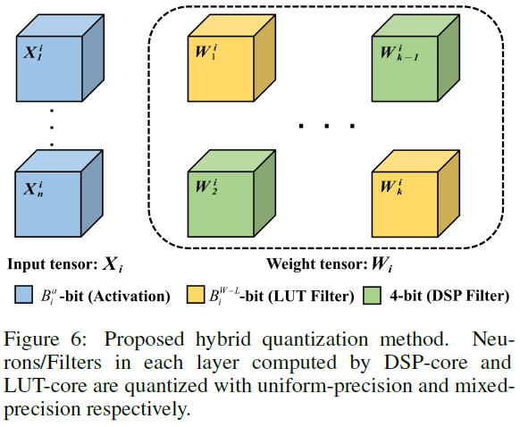
Hybrid Quantization with Mixed Precision

Slide 3
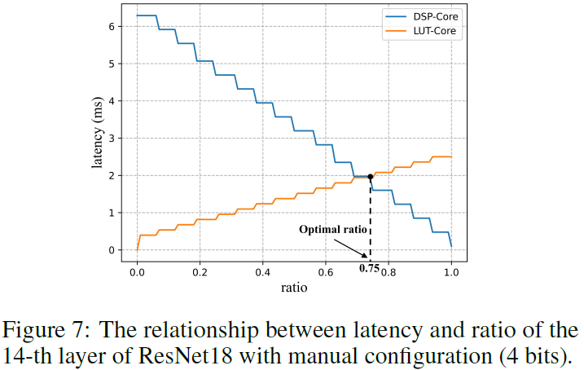


Neuron-based workload split

Slide 4
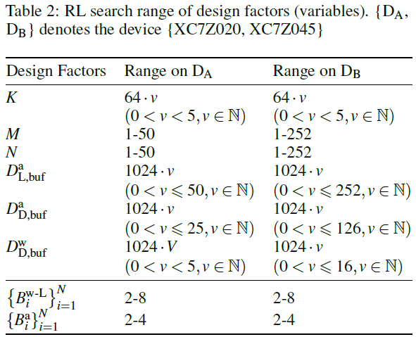
Design Space
Resource Allocation
Quantization bit-widths

Slide 5
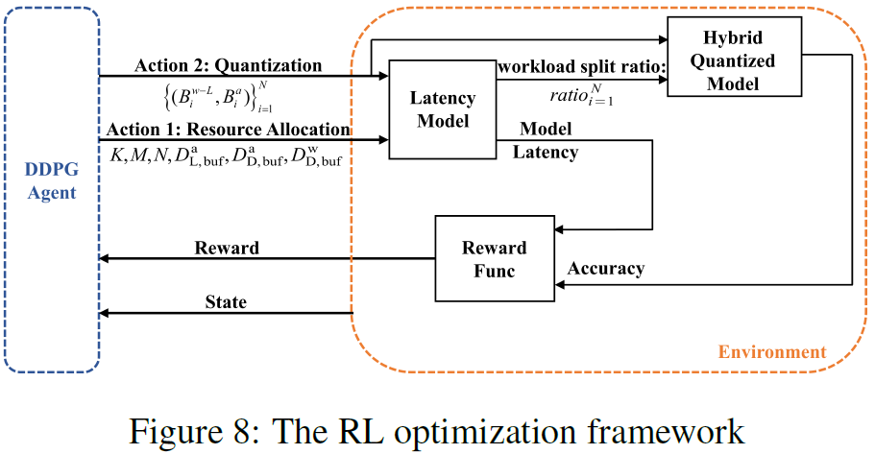
RL-based Design Space Exploration (Joint Search)

Slide 6




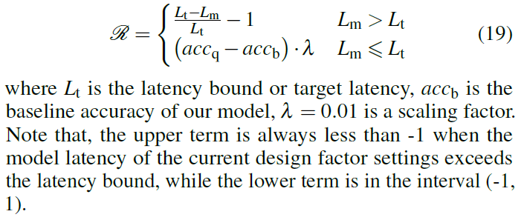



RL space
Action Space:
State Space:
Reward:

Slide 7
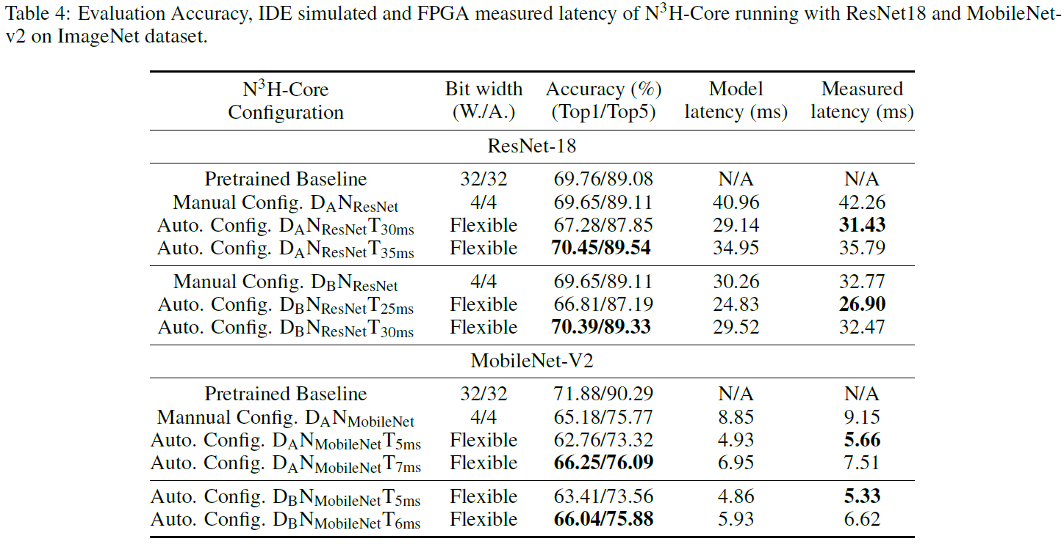
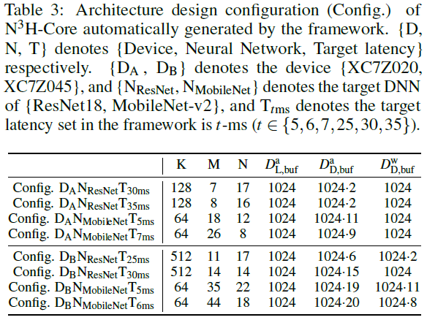
Results
K：输入input channel计算并行度
resnet上更大：由于mobilenet的depth-wise layers
Mobilenet: More BRAMs to DSP-core

Slide 8
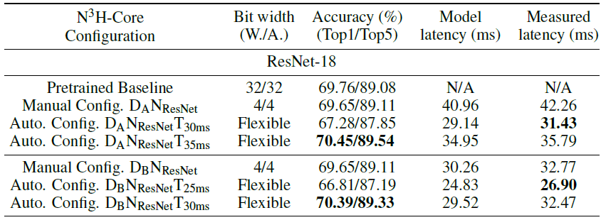
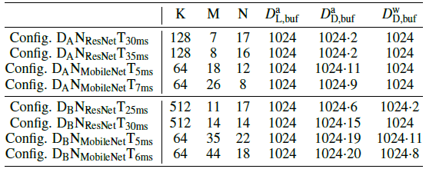
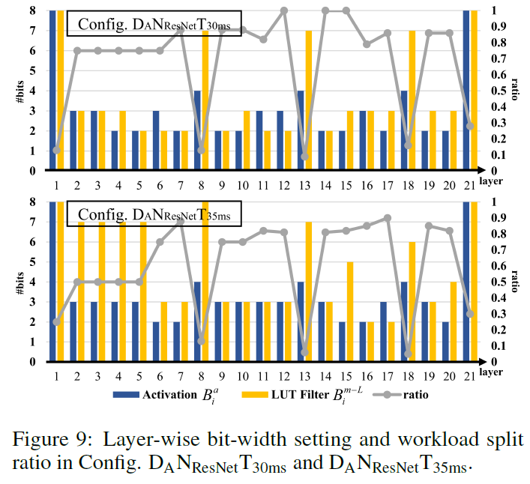
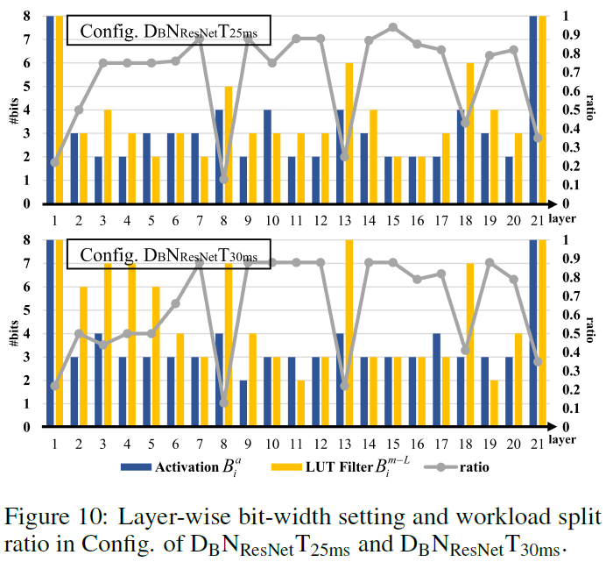
Results

Slide 9
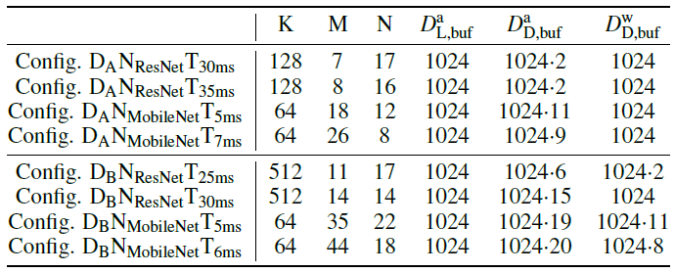

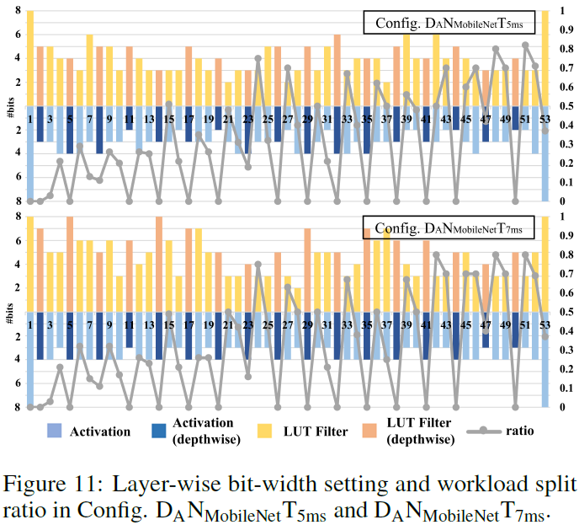
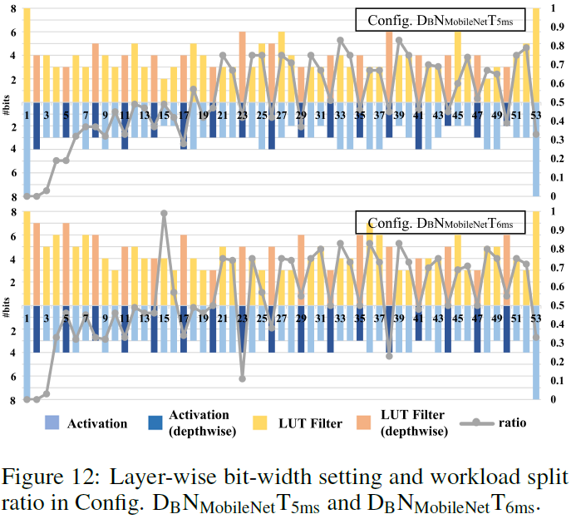
Results

Slide 10
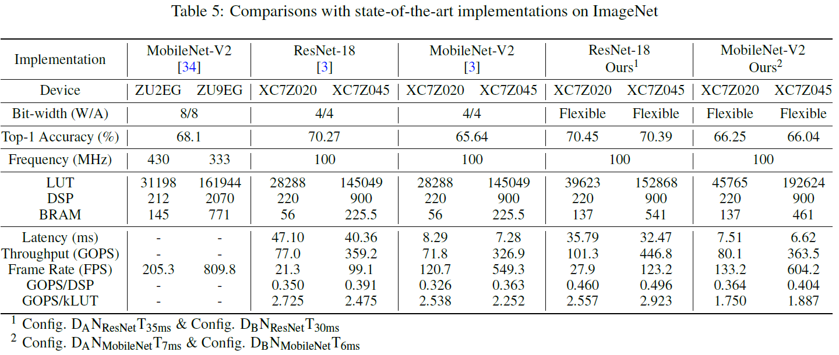
Results

